Slide 1

MACHINE LEARNING ACCELERATOR
Tabular Data – Lecture 2

Slide 2
Course Overview
Lecture 1
Lecture 2
Lecture 3
Introduction to ML
Model Evaluation
Train-Validation-Test
Overfitting
Exploratory Data Analysis
K Nearest Neighbors (KNN)
Feature Engineering
Tree-based Models
Decision Tree
Random Forest
Hyperparameter Tuning
AWS AI/ML Services
Optimization
Regression Models
Regularization
Boosting
Neural Networks
AutoML

Slide 3
Feature Engineering

Slide 4
Feature Engineering
Feature engineering: Use domain and data knowledge to create novel features as inputs for ML models from the raw data provided.
Numerical data
Categorical data
Train ML Model using meaningful numerical features
Tabular Raw Data
Text data
…

Slide 5
Feature Engineering
Feature engineering: Use domain and data knowledge to create novel features as inputs for ML models from the raw data provided.
Intuition: What information would a human use to predict?
Often more art than science!
Numerical data
Categorical data
Feature Engineering
Train ML Model using meaningful numerical features
Tabular Raw Data
Text data
Select features
…

Slide 6
Feature Engineering
Feature engineering: Use domain and data knowledge to create novel features as inputs for ML models from the raw data provided.
Intuition: What information would a human use to predict?
Often more art than science!
Numerical data
Categorical data
Feature Engineering
Train ML Model using meaningful numerical features
Tabular Raw Data
Text data
Select features
Feature construction (multiplication, squaring,
polynomial features, logs, other kernels, etc.)
…

Slide 7
Feature Engineering
Feature engineering: Use domain and data knowledge to create novel features as inputs for ML models from the raw data provided.
Intuition: What information would a human use to predict?
Often more art than science!
Numerical data
Categorical data
Feature Engineering
Train ML Model using meaningful numerical features
Tabular Raw Data
Text data
Select features
Feature construction (multiplication, squaring, etc)
Feature extraction (encoding, vectorization)
Feature selection (dimensionality reduction)
…

Slide 8
Encoding Categoricals

Slide 9
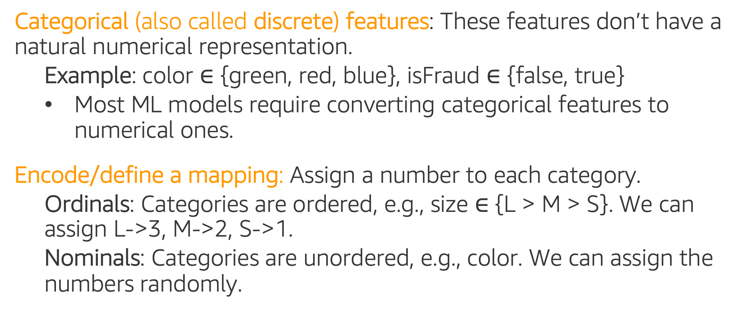
Encoding Categorical Features
Categorical (also called discrete) features: These features don’t have a natural numerical representation.
Example: color $∈$ {green, red, blue}, isFraud $∈$ {false, true}
Most ML models require converting categorical features to numerical ones.
Encode/define a mapping: Assign a number to each category.
Ordinals: Categories are ordered, e.g., size $∈$ {L > M > S}. We can assign L->3, M->2, S->1.
Nominals: Categories are unordered, e.g., color. We can assign the numbers randomly.

Slide 10
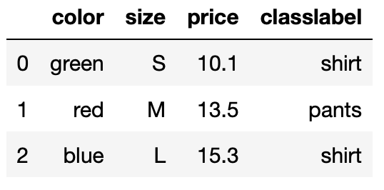
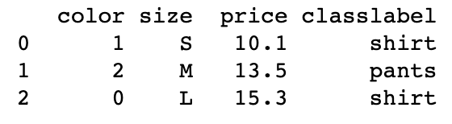
Encoding Categorical Features
LabelEncoder: sklearn encoder, encodes target labels with value between 0 and n_classes-1 -
Encodes target labels values, y (or one feature only!), and not the input X.
Can be used to transform non-numerical labels or numerical labels.
.fit(), .transform()
from sklearn.preprocessing import LabelEncoder
le = LabelEncoder()
df['color'] = le.fit_transform(df['color'])
Let’s encode one feature, e.g. the color field.

Slide 11
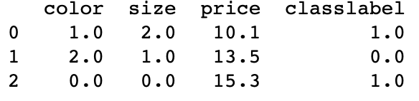
Encoding Categorical Features
OrdinalEncoder: sklearn encoder, encodes categorical features as an integer array -
Encodes (two or more) categorical features (doesn’t work on one feature!)
Returns a single column of integers (0 to n_categories - 1) per feature.
.fit(), .transform()
from sklearn.preprocessing import OrdinalEncoder
oe = OrdinalEncoder()
df[['color','size','classlabel']] = oe.fit_transform(df[['color','size','classlabel']])
Let’s encode all categorical fields.

Slide 12
Encoding Categorical Features
Problem: Encoding categorical features with integers is wrong because the ordering and size of the integers is meaningless.
One-hot-encoding: Explode the categorical features into many binary features (as many categories per feature).
OneHotEncoder: sklearn one-hot encoder, encodes categorical features as a one-hot numeric array -
Does not automatically name the new binary features.
Works on two or more features (for one-hot encoding of one feature alone should use LabelBinarizer instead!)
get_dummies: pandas one-hot encoder
.fit(), .transform()

Slide 13
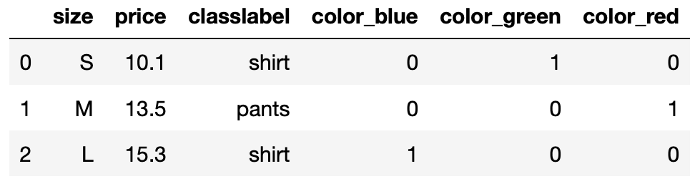
Encoding Categorical Features
get_dummies: pandas one-hot encoder, converts categorical features into new “dummy”/indicator features.
Automatically names the new binary features.
pd.get_dummies(df, columns=['color'])

Slide 14
Encoding with many categories
Define a hierarchy structure:
Example: For a zip code feature, can try to use
regions -> states -> city as the hierarchy,
and can choose a specific level to encode the zip code feature.
Group/bin the categories into fewer groups by similarity:
Example: For some user demographics dataset, create age groups: 1-15, 16-22, 23-30, and so forth.

Slide 15
Encoding with many categories
Target Encoding: Encode using values that can explain the target.
Example: Averaging the target value for each category. Then, replace the categorical values with the average target value.
x₁ | x₂ | y
a | c | 1
a | d | 1
b | c | 0
a | d | 0
a | d | 0
a | d | 1
b | d | 0
x₁ | x₂ | y
0.6 | 0.5 | 1
0.6 | 0.4 | 1
0 | 0.5 | 0
0.6 | 0.4 | 0
0.6 | 0.4 | 0
0.6 | 0.4 | 1
0 | 0.4 | 0
x₁ -> cat a -> 3/5 = 0.6
x₁ -> cat b -> 0/2 = 0
x₂ -> cat c -> 1/2 = 0.5
x₂ -> cat d -> 2/5 = 0.4

Slide 16
Text Preprocessing

Slide 17
Machine Learning with Text Data
Text is a common data type such as titles, names, reviews or any freeform input.
ML models need well-defined numerical data.
Text data
Text preprocessing
(Cleaning and formatting)
Vectorization
(Convert to numbers)
Train ML Model using numerical data
Lower case,
Stop words removal,
Stemming,
Lemmatization
Word Representation
K Nearest Neighbors (KNN),
Decision Tree,
Regression,
Neural Network, etc.

Slide 18
Cleaning Text Data
Motivation: Messy text harder to find patterns in.
Normalize text by removing noise: convert to lowercases, strip whitespaces, remove special characters, remove markups, etc.
Example: The following two sentences have similar meaning but may seem quite different to a text classifier (i.e. sentiment detector):
“The countess (Rebecca) considers\n the boy to be quite naïve.”
“countess rebecca considers boy naive”

Slide 19
Tokenization
Tokenization: Splits text into small parts by white space and punctuation.
Example:
Tokens will be used for further cleaning and vectorization.
Sentence | Tokens
“I don’t like eggs.” | “I”, “do”, “n’t”, “like”, “eggs”, “.”

Slide 20
Stop Words Removal
Stop Words: Some words that frequently appear in texts, but they don’t contribute too much to the overall meaning.
Common stop words: “a”, “the”, “so”, “is”, “it”, “at”, “in”, “this”, “there”, “that”, “my”, “by”, “nor”
Example:
Original sentence | Without stop words
“There is a tree near the house.” | “tree near house”

Slide 21
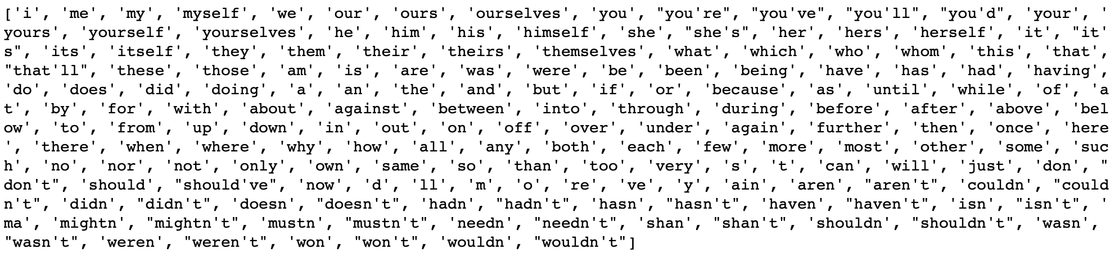
Stop Words Removal
Stop Words from the Natural Language Tool Kit (NLTK) library:
Is this a good list of stop words for a binary text classification of product reviews (positive or negative review) ?

Slide 22
Stemming
Set of rules to slice a string to a substring that usually refers to a more general meaning.
The goal is to remove word affixes (particularly suffixes) such as “s”, “es”, “ing”, “ed”, etc.
“playing”
“played” “play”
”plays”
The issue: It doesn’t usually work with irregular forms such as irregular verbs: “taught”, “brought”, etc.

Slide 23
Text Vectorization

Slide 24
Text Vectorization: Bag of Words
ML models need well-defined numerical data.
‘Bag of Words’ (BoW) method:
Converts text data into numerical features.
Referred as feature extraction, as we extracted important information from the original text in a numeric form
For each word in a document, we get a number; it can be:
binary (1 or 0, present or not)
word counts or frequencies

Slide 25
Bag of Words: Binary
Simple example for binary features:
 | a | cat | dog | is | it | my | not | old | wolf
“It is a dog.” | 1 | 0 | 1 | 1 | 1 | 0 | 0 | 0 | 0
“my cat is old” | 0 | 1 | 0 | 1 | 0 | 1 | 0 | 1 | 0
“It is not a dog, it is a wolf.” | 1 | 0 | 1 | 1 | 1 | 0 | 1 | 0 | 1

Slide 26
Bag of Words: Counts
Simple example for word counts:
 | a | cat | dog | is | it | my | not | old | wolf
“It is a dog.” | 1 | 0 | 1 | 1 | 1 | 0 | 0 | 0 | 0
“my cat is old” | 0 | 1 | 0 | 1 | 0 | 1 | 0 | 1 | 0
“It is not a dog, it is a wolf.” | 2 | 0 | 1 | 2 | 2 | 0 | 1 | 0 | 1

Slide 27
Term Frequency (TF)
Term frequency (TF): Increases the weights of common words in a document.
 | a | cat | dog | is | it | my | not | old | wolf
“It is a dog.” | 0.25 | 0 | 0.25 | 0.25 | 0.25 | 0 | 0 | 0 | 0
“my cat is old” | 0 | 0.25 | 0 | 0.25 | 0 | 0.25 | 0 | 0.25 | 0
“It is not a dog, it is a wolf.” | 0.22 | 0 | 0.11 | 0.22 | 0.22 | 0 | 0.11 | 0 | 0.11

Slide 28
Inverse Document Frequency (IDF)
Inverse document frequency (IDF): Decreases the weights for commonly used words, and increases weights for rare words in the vocabulary.
Example:
term | idf
a
cat
dog
is
it
my
not
old
wolf

Slide 29
Inverse Doc. Freq. (TF-IDF)
Term Freq. Inverse Doc. Freq (TF-IDF): Combines term frequency and inverse document frequency.
 | a | cat | dog | is | it | my | not | old | wolf
“It is a dog.” | 0.25 | 0 | 0.25 | 0.22 | 0.25 | 0 | 0 | 0 | 0
“my cat is old” | 0 | 0.3 | 0 | 0.22 | 0 | 0.3 | 0 | 0.3 | 0
“It is not a dog, it is a wolf.” | 0.22 | 0 | 0.11 | 0.19 | 0.22 | 0 | 0.13 | 0 | 0.13

Slide 30
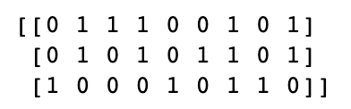
Bag of Words in sklearn
CountVectorizer: sklearn text vectorizer, converts a collection of text documents to a matrix of token counts -
.fit(), .transform()
from sklearn.feature_extraction.text import CountVectorizer
countVectorizer = CountVectorizer(binary=True)
sentences = ['This is the first document.',
'This is the second document.',
'and the third one.',
]
X = countVectorizer.fit_transform(sentences)
print(X.toarray())
vocabulary =
{and, document, first, is, one, second, the, third, this}

Slide 31
Bag of Words in sklearn
TfidfVectorizer: sklearn text vectorizer, converts a collection of text documents to a matrix of TF-IDF features -
Returns normalized term frequencies matrix when “use_idf = False”:
Returns smoother TF-IDF matrix when “use_idf = False”:
.fit(), .transform()
from sklearn.feature_extraction.text import TfidfVectorizer
vectorizer = TfidfVectorizer(use_idf=False)
from sklearn.feature_extraction.text import TfidfVectorizer
vectorizer = TfidfVectorizer(use_idf=True)

Slide 32

Text Preprocessing Hands-on
In this notebook we perform the following tasks:
Text cleaning
Text preprocessing
Text vectorization - get binary Bag of Words features
MLA-TAB-Lecture2-Text-Processing.ipynb

Slide 33
Tree-based Models

Slide 34
Problem: Package Delivery Prediction
Given this dataset, let’s predict package on time delivery (yes/no) using a Decision Tree.
Iteratively split the dataset into subsets (branches), such that the final subsets (leaves) contain mostly one class.
Weather | Demand | Address | ontime
Sunny | High | Correct | No
Sunny | High | Misspelled | No
Overcast | High | Correct | Yes
Rainy | High | Correct | Yes
Rainy | Normal | Correct | Yes
Rainy | Normal | Misspelled | No
Overcast | Normal | Correct | Yes
Sunny | High | Correct | No
Sunny | Normal | Correct | Yes
Rainy | Normal | Misspelled | Yes
Sunny | Normal | Misspelled | Yes
Overcast | High | Misspelled | Yes
Overcast | Normal | Correct | Yes
Rainy | High | Misspelled | No

Slide 35
ML Model: Decision Tree
Weather | Demand | Address | ontime
Sunny | High | Correct | No
Sunny | High | Misspelled | No
Overcast | High | Correct | Yes
Rainy | High | Correct | Yes
Rainy | Normal | Correct | Yes
Rainy | Normal | Misspelled | No
Overcast | Normal | Correct | Yes
Sunny | High | Correct | No
Sunny | Normal | Correct | Yes
Rainy | Normal | Misspelled | Yes
Sunny | Normal | Misspelled | Yes
Overcast | High | Misspelled | Yes
Overcast | Normal | Correct | Yes
Rainy | High | Misspelled | No
Weather
Sunny
Rainy
Overcast
Demand
Address
Yes
High
Normal
Misspelled
Correct
No
Yes
No
Yes

Slide 36
Decision Trees
Decision Trees are flowchart-like structures that can be used for classification or regression tasks.
Root Node
the start node
How to Learn a Decision Tree?
Weather
Sunny
Rainy
Overcast
Internal Nodes
exactly one incoming node and two or more outgoing edges
have attribute conditions to separate records
Demand
Address
Yes
High
Normal
Misspelled
Correct
Leaf or Terminal Nodes
exactly one incoming edge and no outgoing edges
it is assigned a class label (classification) or value (regression)
No
Yes
No
Yes

Slide 37
Learn a Decision Tree
ID3* Algorithm:
(Repeat the steps below)
Select “the best feature” to split (we will see how to select)
Separate the training samples according to the selected feature
Stop if we have samples from a single class or if we used all features, and note it as a leaf node
Top down approach: Grow the tree from root node to leaf nodes.
*ID3 (Iterative Dichotomiser 3)

Slide 38
Decision Trees: Numerical Example
Given this dataset, let’s predict the y class (1 vs. 2) using a Decision Tree.
Iteratively split the dataset into subsets from a root node, such that the leaf nodes contain mostly one class (as pure as possible).
x₁ | x₂ | y
3.5 | 2 | 1
5 | 2.5 | 2
1 | 3 | 1
2 | 4 | 1
4 | 2 | 1
6 | 6 | 2
2 | 9 | 2
4 | 9 | 2
5 | 4 | 1
3 | 8 | 2

Slide 39
Decision Trees: Numerical Example
x₂
Class 1
Class 2
x₁ | x₂ | y
3.5 | 2 | 1
5 | 2.5 | 2
1 | 3 | 1
2 | 4 | 1
4 | 2 | 1
6 | 6 | 2
2 | 9 | 2
4 | 9 | 2
5 | 4 | 1
3 | 8 | 2
9
8
7
6
5
4
3
2
1
1 2 3 4 5 6
x₁

Slide 40
Decision Trees: Numerical Example
x₂
Class 1
Class 2
Class: 1, 2
9
8
7
6
5
4
3
2
1
What feature (x₁ or x₂) to use to split this dataset, to best separate class 1 from class 2?
[select the splits such that the descendent subsets are “purer” than their parents]
1 2 3 4 5 6
x₁

Slide 41
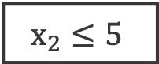
Decision Trees: Numerical Example
x₂
Class 1
Class 2
$$x_{2}≤5$$
9
8
7
6
5
4
3
2
1
Yes
No
Class: 1, 2
Class = 1
What feature (x₁ or x₂) to use to split this subset, to best separate class 1 from class 2?
5
1 2 3 4 5 6
x₁

Slide 42
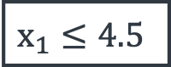
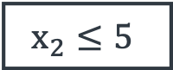
Decision Trees: Numerical Example
x₂
Class 1
Class 2
$$x_{2}≤5$$
$$x_{2}≤5$$
9
8
7
6
5
4
3
2
1
Yes
No
$$x_{1}≤4.5$$
Class = 1
Yes
No
5
Class = 2
Class: 1, 2
What feature (x₁ or x₂) to use to split this subset, to best separate class 1 from class 2?
4.5
x₁
1 2 3 4 5 6

Slide 43

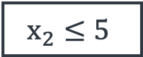
Decision Trees: Numerical Example
x₂
Class 1
Class 2
$$x_{2}≤5$$
$$x_{2}≤5$$
9
8
7
6
5
4
3
2
1
Yes
No
$$x_{1}≤4.5$$
Class = 1
Yes
No
5
?
Class = 2
$$x_{2}≤3$$
3
Yes
No
Class = 1
Class = 2
4.5
x₁
1 2 3 4 5 6

Slide 44
Decision Trees: Example
[9+, 5-]
Weather | Demand | Address | ontime
Sunny | High | Correct | No
Sunny | High | Misspelled | No
Overcast | High | Correct | Yes
Rainy | High | Correct | Yes
Rainy | Normal | Correct | Yes
Rainy | Normal | Misspelled | No
Overcast | Normal | Correct | Yes
Sunny | High | Correct | No
Sunny | Normal | Correct | Yes
Rainy | Normal | Misspelled | Yes
Sunny | Normal | Misspelled | Yes
Overcast | High | Misspelled | Yes
Overcast | Normal | Correct | Yes
Rainy | High | Misspelled | No
Class: Yes, No
What feature (’Weather’, ‘Demand’ or ‘Address’) to use to split the dataset, to best separate class ‘No’ from class ‘Yes’?
[select the splits such that the descendent subsets are “purer” than their parents]

Slide 45
Best Feature to Split with?
A good split results in overall less uncertainty (impurity). For example:
Weather | Demand | Address | ontime
Sunny | High | Correct | No
Sunny | High | Misspelled | No
Overcast | High | Correct | Yes
Rainy | High | Correct | Yes
Rainy | Normal | Correct | Yes
Rainy | Normal | Misspelled | No
Overcast | Normal | Correct | Yes
Sunny | High | Correct | No
Sunny | Normal | Correct | Yes
Rainy | Normal | Misspelled | Yes
Sunny | Normal | Misspelled | Yes
Overcast | High | Misspelled | Yes
Overcast | Normal | Correct | Yes
Rainy | High | Misspelled | No
Not too sure
[9+, 5-]
Weather
Sunny
Rainy
Overcast
[2+, 3-]
Not too sure
[3+, 2-]
[4+, 0-]
Not too sure
Absolutely sure

Slide 46
Best Feature to Split with?
A good split results in overall less uncertainty (impurity). For example:
Weather | Demand | Address | ontime
Sunny | High | Correct | No
Sunny | High | Misspelled | No
Overcast | High | Correct | Yes
Rainy | High | Correct | Yes
Rainy | Normal | Correct | Yes
Rainy | Normal | Misspelled | No
Overcast | Normal | Correct | Yes
Sunny | High | Correct | No
Sunny | Normal | Correct | Yes
Rainy | Normal | Misspelled | Yes
Sunny | Normal | Misspelled | Yes
Overcast | High | Misspelled | Yes
Overcast | Normal | Correct | Yes
Rainy | High | Misspelled | No
Not too sure
[9+, 5-]
Not too sure
[9+, 5-]
Demand
Address
High
Normal
Correct
Misspelled
[3+, 4-]
[1+, 6-]
[6+, 2-]
[3+, 3-]
Not too sure
Somewhat sure
Somewhat sure
Not too sure

Slide 47
Best Feature to Split with?
What split will results in overall less uncertainty (impurity)?
Not too sure
Not too sure
Not too sure
[9+, 5-]
[9+, 5-]
[9+, 5-]
Weather
Demand
Address
Sunny
Rainy
High
Normal
Correct
Misspelled
Overcast
[2+, 3-]
Not too sure
[3+, 2-]
[3+, 4-]
[1+, 6-]
[6+, 2-]
[3+, 3-]
[4+, 0-]
Not too sure
Absolutely sure
Not too sure
Somewhat sure
Somewhat sure
Not too sure

Slide 48
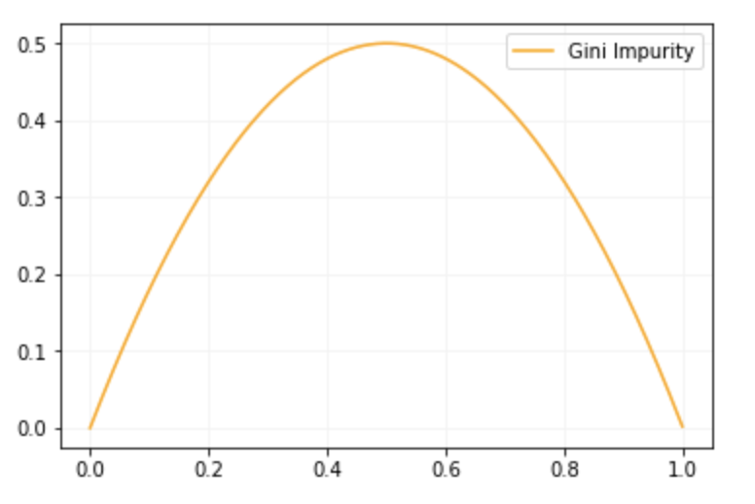
How to Measure Uncertainty
If we have only + samples or only – samples:
Low uncertainty
-
-
-
-
+
-
+
+
+
-
-
-
+
-
+
+
+
+
-
-
-
+
+
+

Slide 49
How to Measure Uncertainty
If we have mix of + and - samples:
High uncertainty
-
-
-
-
+
-
+
+
+
-
-
-
+
-
+
+
+
+
-
-
-
+
+
+

Slide 50
How to Measure Uncertainty
We will use Gini impurity:
( : number of classes, : prob. of picking a datapoint from class )
Another measure:
Entropy: More details
Gini Impurity curve
-
-
-
-
+
-
+
+
+
-
-
-
+
-
+
+
+
+
-
-
-
+
+
+

Slide 51
Information Gain & Feature Selection
Information Gain: Expected reduction in uncertainty due to selected feature.
“Weather”, “Demand” or “Address”, which one should we select as feature to split?
Gain =
Impurity before split
Impurity after split
[9+, 5-]
[9+, 5-]
[9+, 5-]
Weather
Demand
Address
Sunny
Rainy
Misspelled
Correct
Overcast
High
Normal

Slide 52
Calculating Gini Impurity
Gini impurity:
Not too sure
[9+, 5-]
Weather
Sunny
Rainy
Overcast
[2+, 3-]
Not too sure
[3+, 2-]
[4+, 0-]
Not too sure
Absolutely sure

Slide 53
Calculating Gini Impurity
Gini impurity:
Not too sure
[9+, 5-]
Weather
Sunny
Rainy
Overcast
[2+, 3-]
Not too sure
[3+, 2-]
[4+, 0-]
Not too sure
Absolutely sure
(Weighted sum of impurities)

Slide 54
Information Gain & Feature Selection
Not too sure
[9+, 5-]
Gain =
Weather
Impurity before split
Impurity after split
Sunny
Rainy
Overcast
[2+, 3-]
Not too sure
[3+, 2-]
Gain(“Weather”) = 0.46-0.34=0.12
[4+, 0-]
Not too sure
Absolutely sure

Slide 55
Information Gain & Feature Selection
Comparing gains for each feature:
Gain(“Weather”) = 0.46-0.34 = 0.12
Gain(“Demand”) = 0.46-0.37 = 0.09
Gain(“Address”) = 0.46-0.43 = 0.03
“Weather” has the highest gain of all, so we start the tree with the “Weather” feature as the root node!
[9+, 5-]
[9+, 5-]
Demand
Address
High
Normal
Correct
Misspelled
[3+, 4-]
[1+, 6-]
[6+, 2-]
[3+, 3-]

Slide 56
Recap ID3 Algorithm
ID3 Algorithm*: Repeat
Select “the best feature” to split using Information Gain.
Separate the training samples according to the selected feature.
Stop if have samples from a single class or if all features used, and note a leaf node.
Assign the leaf node the majority class of the samples in it.
Feature with highest Information Gain
A
B
C
Feature with highest Information Gain given A
Feature with highest Information Gain given C
D
E
Class 1
F
G
Class 2
Class 1
Class 2
Class 1
*To build a Decision Tree Regressor: 1. Replace the Information Gain with Standard Deviation Reduction. 3. Stop when numerical values are homogeneous (standard deviation is zero) or if used all features, and note it as a leaf node. 4. Assign the leaf node the average value of its samples.

Slide 57
Decision Trees in sklearn
DecisionTreeClassifier: sklearn Decision Tree classifier (there is also a Regressor version) -
DecisionTreeClassifier(criterion='gini’,
max_depth=None, min_samples_split=2,
min_samples_leaf=1, class_weight=None)
The full interface is larger.
.fit(), .predict()

Slide 58
Ensemble Methods: Bagging

Slide 59
Ensemble Learning
Ensemble methods create a strong model by combining the predictions of multiple weak models (aka weak learners or base estimators) built with a given dataset and a given learning algorithm.
We discuss Bagging and Boosting ensemble models.
Weak Model 1
Weak Model 2
Ensemble Prediction
Data
…
Weak Model N

Slide 60
Bagging (Bootstrap Aggregating)
Bagging (Bootstrap Aggregating) method:
Randomly draw N samples of a fix size from the training set (with replacement) - bootstrap technique
Example: given data [1, 2, 3, 4, 5, 6, 7, 8, 9], samples of size 6 are:
[ 1, 1, 2, 4, 9, 9]; [ 2, 4, 5, 5, 7, 7]; [ 1, 1, 1, 1, 1, 1]; [ 1, 2, 4, 5, 7,9]
Build independent estimators of same type on each subset
Majority vote or average the predictions from all estimators
Bagging Decision Trees: Random Forest

Slide 61
Bagging trees: Random Forest
Random Forest: Bagging Decision Trees
Draw random subsets (with replacement) from the original dataset
Build a decision tree on each bootstrapped subset
Combine predictions from each tree for final prediction
Data 1
Tree 1
Prediction 1
Data 2
Tree 2
Prediction 2
Prediction
Data
…
…
…
Data N
Tree N
Prediction N

Slide 62
Random Forest in sklearn
RandomForestClassifier: sklearn Random Forest classifier (there is also a Regressor version) -
RandomForestClassifier(n_estimators=100,
max_samples=None, max_features='auto’,
criterion='gini’, max_depth=None, min_samples_split=2,
min_samples_leaf=1, class_weight=None)
The full interface is larger.
.fit(), .predict()

Slide 63
Bagging in sklearn
BaggingClassifier: sklearn very general interface for bagging which can be provided any base_estimator -
BaggingClassifier(base_estimator=None, n_estimators=10,
max_samples=1.0, bootstrap=True)
The full interface is larger.
.fit(), .predict()

Slide 64
Hyperparameter Tuning

Slide 65
Hyperparameter Tuning
Hyperparameters are ML algorithms parameters that affect the structure of the algorithms and the performance of the models.
Examples of hyperparameters:
K Nearest Neighbors: n_neighbors, metric
Decision trees: max_depth, min_samples_leaf, class_weight, criterion
Random Forest: n_estimators, max_samples
Ensemble Bagging: base_estimator, n_estimators
Hyperparameter tuning looks for the best combination of hyperparameters (combination that maximizes model performance).

Slide 66
Grid Search in sklearn
GridSearchCV: sklearn basic hyperparameter tuning method, finds the optimum combination of hyperparameters by exhaustive search over specified parameter values -
GridSearchCV(estimator, param_grid, scoring=None)
Example: Hyperparameters for a Decision Tree:
param_grid ={max_depth: [5, 10, 50, 100, 250],
min_samples_leaf: [15, 20, 25, 30, 35]}
.fit(), .predict()
Hyperparameter 2
Hyperparameter 1
Total hyperparameters combinations
5 x 5 = 25
[5, 15], [5, 20], [5, 25], [10, 15], …

Slide 67
Randomized Search in sklearn
RandomizedSearchCV: randomized search on hyperparameters
Chooses a fixed number (given by parameter n_iter) of random combinations of hyperparameter values and only tries those.
Can sample from distributions (sampling with replacement is used), if at least one parameter is given as a distribution.
RandomizedSearchCV(estimator, param_distributions,
n_iter=10, scoring=None)
Example: Hyperparameters for a Decision Tree:
param_grid ={max_depth: [5, 10, 50, 100, 250],
min_samples_leaf: uniform(15,35,5)}
Hyperparameter 2
Hyperparameter 1

Slide 68
Bayesian Search
Bayesian Search method keeps track of previous hyperparameter evaluations and builds a probabilistic model.
It tries to balance exploration (uncertain hyperparameter set) and exploitation (hyperparameters with a good chance of being optimum)
It prefers points near the ones that worked well
AWS SageMaker uses Bayesian Search for hyperparameter optimization.

Slide 69
Data Preprocessing with
Pipeline (sklean)

Slide 70
Transformers in sklearn
SimpleImputer, StandardScaler, MinMaxScaler, LabelEncoder, OrdinalEncoder, OneHotEncoder, and CountVectorizer belong to sklearn’s transformers class, all have:
.fit() method: learns the transformation from the training dataset
.transform() method: applies the transformation to any dataset (training, validation, test) for preprocessing
On training set can also apply .fit_transform()

Slide 71
ColumnTransformer in sklearn
ColumnTransformer: applies transformers to columns of an array or pandas DataFrame -
Allows different columns or column subsets of the input (numerical, categorical, text) to be transformed separately.
The features generated by each transformer will be concatenated to form a single feature space.
This is useful for mixed tabular datasets, to combine several feature extraction mechanisms or transformations into a single transformer.
.fit(), .transform()

Slide 72
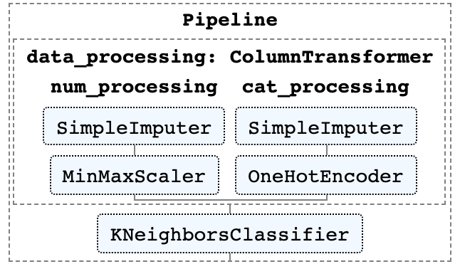
ColumnTransformer and Pipeline
numerical_processing = Pipeline([
(‘num_imputer’, SimpleImputer(strategy='mean’)),
(‘num_scaler’, MinMaxScaler())])
categorical_processing = Pipeline([
(‘cat_imputer’, Imputer(strategy='constant', fill_value='missing’)),
(‘cat_encoder’, OneHotEncoder(handle_unknown='ignore’))])
processor = ColumnTransformer(transformers =[
(‘num_processing’, numerical_processing, ('feature1', 'feature3')),
(‘cat_processing’, categorical_processing, ('feature0', 'feature2’))])
pipeline = Pipeline([(‘data_processing’, processor),
(‘estimator’, KNeighborsClassifier())])
pipeline.fit(X_train, y_train)
predictions = pipeline.predict(X_test)
y_train
X_train
X_test
pipeline.fit
pipeline.predict
.fit_transform
.transform
.fit_transform
.transform
.fit
.predict

Slide 73
Putting it all together
In this notebook, we continue to work with our review dataset to predict the target field
The notebook covers the following tasks:
Exploratory Data Analysis
Splitting dataset into training and test sets
Categoricals encoding and text vectorization
Train a Decision Tree Classifier, and Hyperparameter Tuning
Check the performance metrics on test set
MLA-TAB-Lecture2-Trees.ipynb

Slide 74
AWS SageMaker

Slide 75
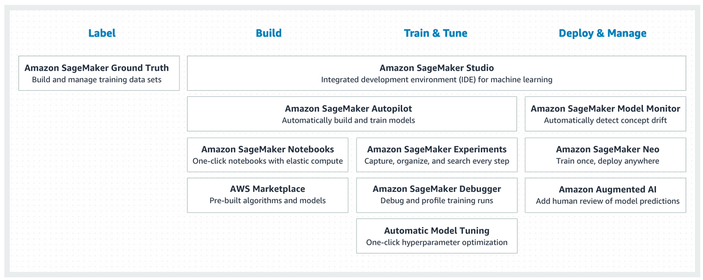
AWS SageMaker: Train and Deploy
SageMaker is an AWS service to easily build, train, tune and deploy ML models: https://aws.amazon.com/sagemaker/
MLA-TAB-Lecture2-SageMaker.ipynb

Slide 76
AWS SageMaker
GroundTruth

Slide 77
SageMaker GroundTruth: Data Labeling
Machine learning can be applied in many different areas. With this, we usually have many different types of labels.
We will use SageMaker GroundTruth tool and label some sample data.
GroundTruth allows users to create labeling tasks and assign them to internal team members or outsource them.

Slide 78
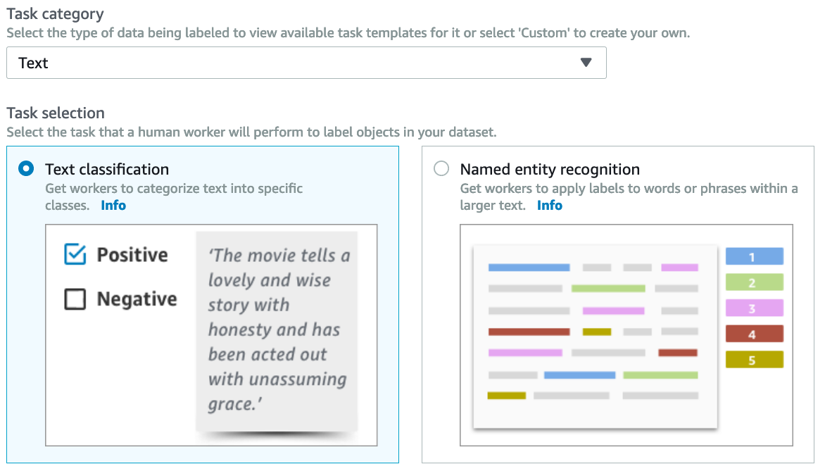
SageMaker GroundTruth: Text Tasks

Slide 79
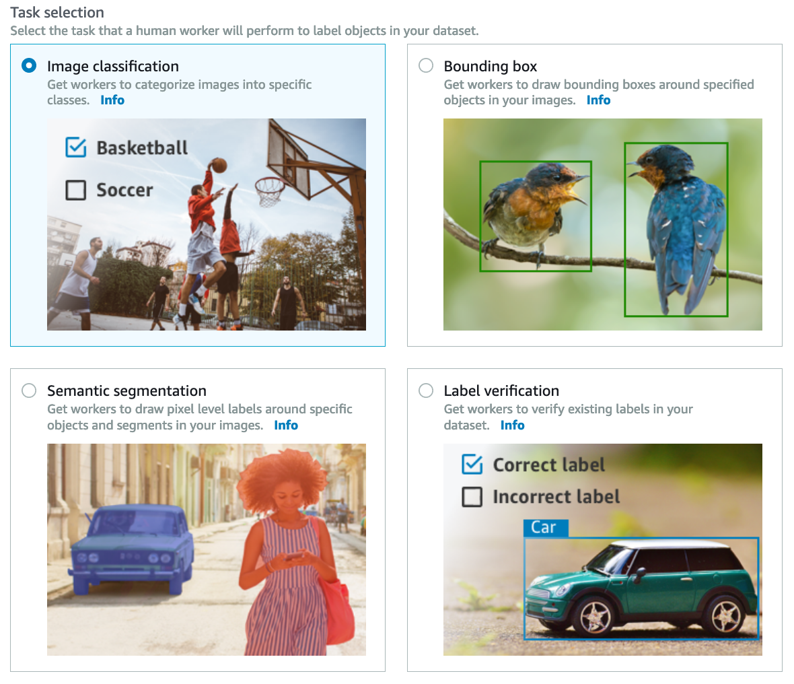
SageMaker GroundTruth: Image Tasks

Slide 80
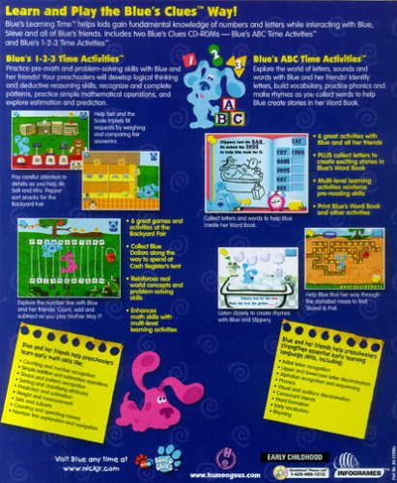

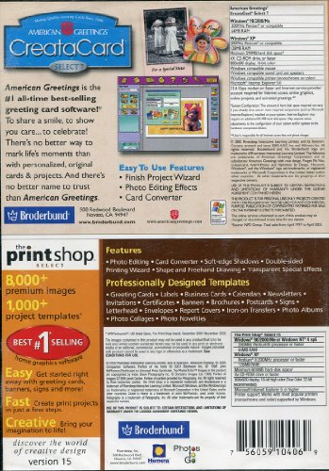


SageMaker GroundTruth: Demo
Assume we will label these 5 images from our final project.
There are two classes: Software and Video game
Image 1
Image 2
Image 3
Image 4
Image 5

Slide 81
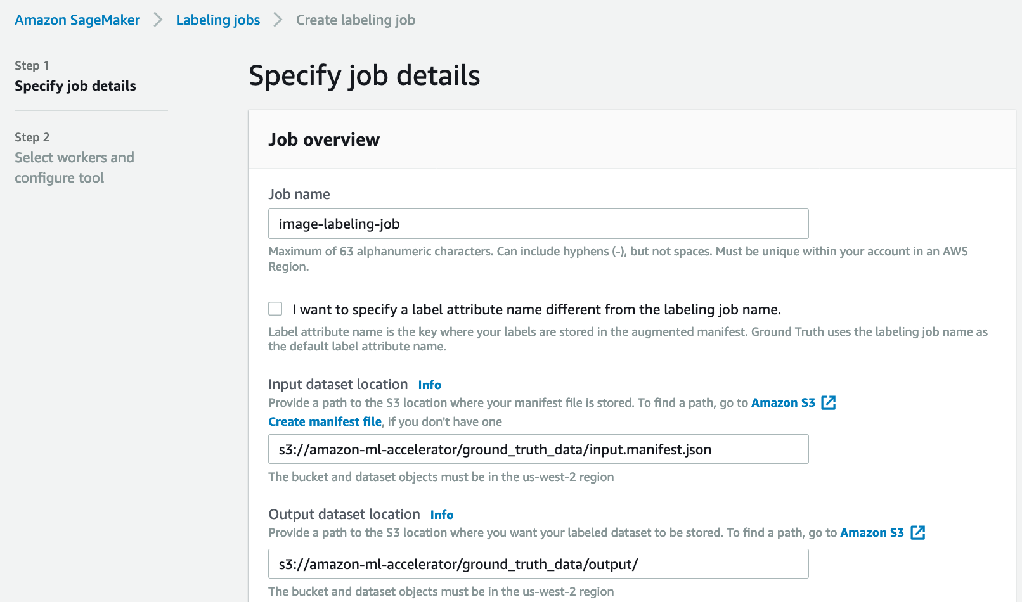
SageMaker GroundTruth: Demo

Slide 82
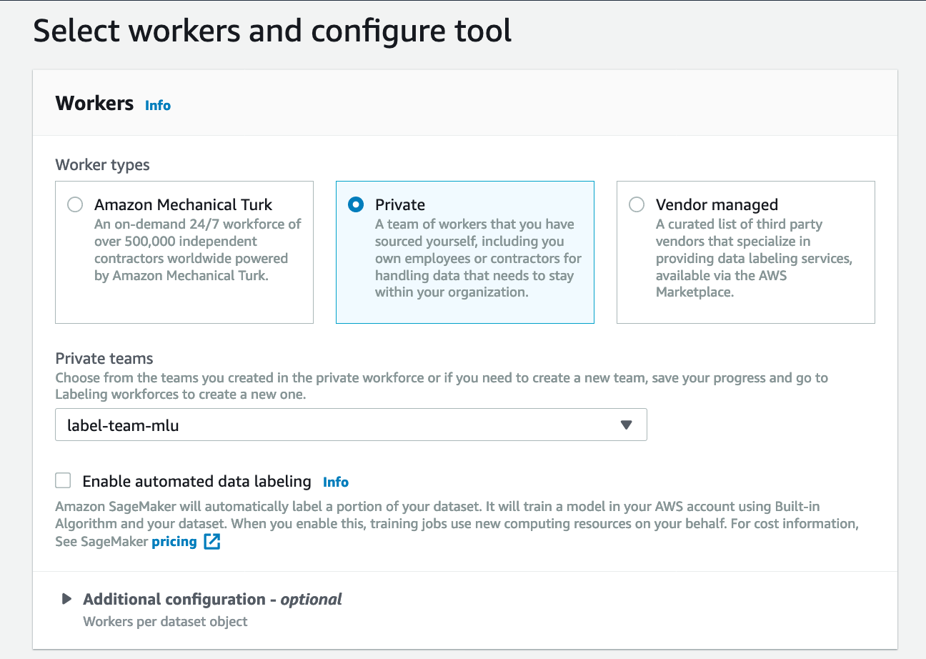
SageMaker GroundTruth: Demo
Checkout this video walkthrough for more details:
https://youtu.be/8J7y513oSsE

Slide 83
Looking Ahead: Lecture 3

Slide 84
Looking Ahead: Lecture 3
Optimization: Model training by Gradient Descent
Regression: Linear and Logistic Regression
Regularization: balance overfitting/underfitting
Boosting: Gradient Boosting Machine (GBM)
Neural Networks: More advanced ML models
MXNet, Gluon, and AutoGluon: More Amazon ML tools that helps you build, train and deploy deep learning models and AutoML models on AWS

